Slide 1


Slide 2

School of Electrical Engineering and Computer Science
EE215
Electronic Devices & Circuits

Slide 3
Lecture 01

Slide 4
Introduction

Slide 5
Instructor’s introduction
Instructor Name : Dr. Shakeel Alvi
Teaching Experience
05 years at CAE (College of Aeronautical Engineering), NUST
07 years at SEECS, NUST
Work Experience: 35 years in PAF
Office : Old SEECS library (But is usually at Sir Habeel’s office)
Lectures on : Wednesday , Thursday, Friday
Labs : Thursday
Email: shakeel.alvi@seecs.edu.pk

Slide 6
Instructor’s introduction
Academic
Awards
PhD : Wireless Communications :Pakistan
MS : Telecommunications & Computers : USA
MS : War studies : Pak
BE : Avionics : Pakistan
BS: Strategic Studies : Pak
Navigational Aids: USA
Satellite Communications : UK
Project management: Pak
Contract management : Pak
Financial management: Pak
Senior Engineering Management : Pak
Roll of Honor (USAF-USA)
TI(M); Govt. of Pakistan
3 times CAS Commendations (PAF)
Merit Certificate (ZABIST-University)
Publications
Publications : 4 Journal papers

Slide 7
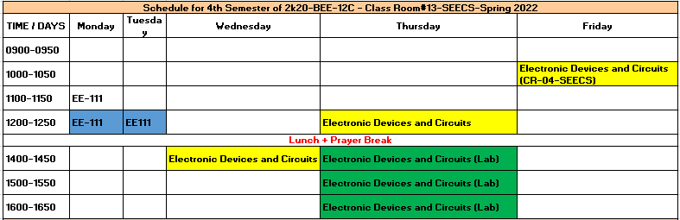
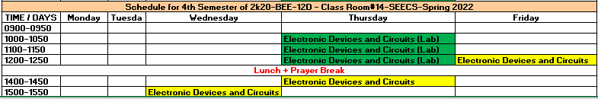

Slide 8
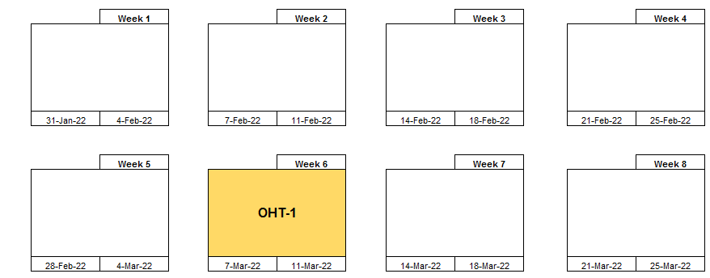
Semester Planner

Slide 9
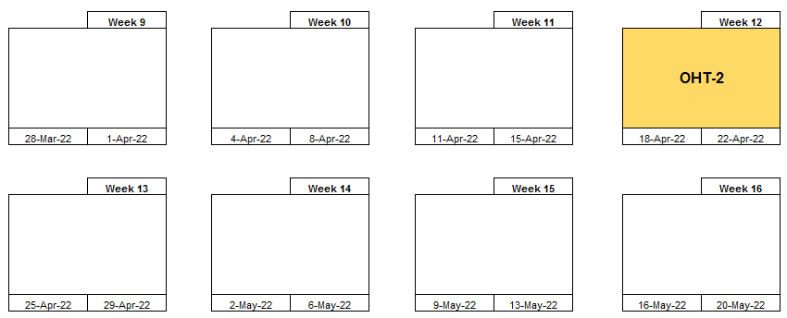

Slide 10
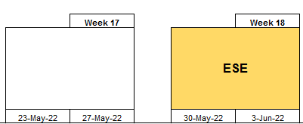

Slide 11
Grading (Provisional )
•Theoretical part: 75%
–Quizzes: 10%
–Assignments: 5%
–OHT1: 15 %
–OHT2: 15 %
– Semester project (CEP) & Lab Exam: 10%
–End Semester Exam – 45%
•Lab – 25%
–Lab work:
–Lab tests:
* Weightages can be changed

Slide 12
S.No | Name | Type | Qty
1 | Arduino Uno | Arduino Uno | 9
2 | 5V DC Relay | 5V DC Relay | 9
3 | WiFi Module | WiFi Module | 8
4 | Arduino Smoke Sensor | Smoke Sensor | 10
5 | Node Mcu | ESP 8266 | 10
6 | Servo motor Small | Servo motor Small | 10
7 | Arduino Bluetooth Module | Bluetooth Module | 10
8 | Wire Set | Interconnected wire for microcontroller | 9
9 | DC Relay | 5V | 49
10 | Current Sensor(PIR) | ACS712-5A | 25
11 | Temperature Sensor | LM 35 | 25
12 | Op-AMP | 741 | 50
13 | NODE MCU | ESP8266 | 15
14 | MOSE FET | IRF 740 | 50
15 | LDR SMALL | LDR | 30
16 | Solar Panel | 50W | 5
17 | Motion Sensor | Sensor | 25
18 | Working Station | Panel | 15

Slide 13
Text & Reference Books
Text Book: Microelectronic Circuits
Sixth Edition, by Sedra/ Smith
Ref Book:
Fundamentals of Microelectronics
by Behzad Razavi

Slide 14
Microelectronic Circuits Sedra/Smith
CH1 Signals and Amplifiers
CH2 Operational Amplifier
CH3 Physics of Semiconductors
CH4 The Diode
CH6 Bipolar Junction Transistors
CH5 MOSFET
CH9 Frequency response

Slide 15
Course Introduction

Slide 16
What is rationale of studying this subject
LCA
ENA
ECD
EDC
In previous semesters
Resistors, Capacitor, Inductor, and their various combination
steady-state and transient response
Now in this semester we will study two types of discrete components
Diodes and transistor(BJT & FET)

Slide 17
This course introduces the students to signals and electronics systems and the need to process the signals containing useful information using electronic circuits.
The first electronic device that is introduced is the Diode; both the qualitative and quantitative description and analysis of the PN junction diode is explained in detail followed by the applications of diode in basic but essential electronics circuits.

Slide 18
This is followed by in depth treatment of the Bipolar Junction Transistor (BJT) and the Metal Oxide Semiconductor Field Effect Transistor (MOSFET); the voltage-current characteristics are explained and analyzed. The DC biasing and DC analysis of basic amplifier are quantitatively analyzed followed by the large signal and small signal analysis of various configuration of the amplifiers.
A short treatment of Frequency analysis of the Common Emitter/Source configuration is then covered followed by the application of transistor as a switch

Slide 19
Class room rules
Class decorum
Attendance
Cheating/ plagiarism
Quizzes / Assignments
Mobiles must be switched off

Slide 20
C H A P T E R 01 Signals and Amplifiers

Slide 21
Signals and Amplifiers
1.1 Signals
1.2 Frequency Spectrum of Signals
1.3 Analog and Digital Signals
1.4 Amplifiers
1.5 Circuit Models for Amplifiers
1.6 Frequency Response of Amplifiers

Slide 22
Introduction
The purpose of this first chapter is to introduce some basic concepts and terminology.
In particular, we shall learn about signals and about one of the most important signal-processing functions electronic circuits are designed to perform, namely, signal amplification.
We shall then look at circuit representations or models for linear amplifiers. These models will be employed in subsequent chapters in the design and analysis of actual amplifier circuits.

Slide 23
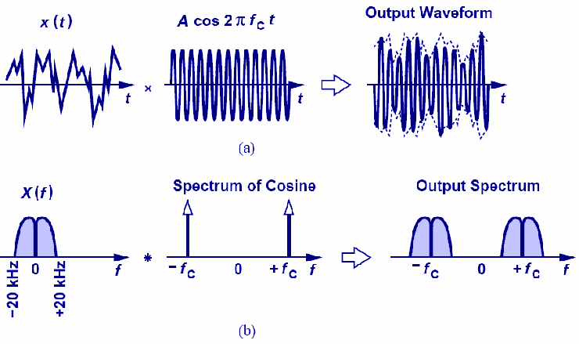
Frequency Up-conversion
Voice is “up-converted” by multiplying with sinusoid of high frequency
When multiplying two sinusoids in time domain, their spectra are convolved in frequency domain

Slide 24
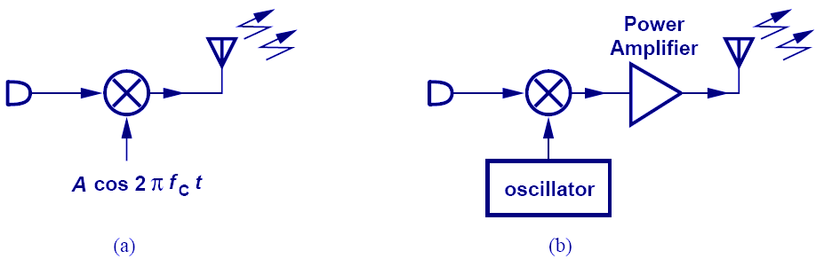
Transmitter
Two frequencies are multiplied and radiated by an antenna.
A power amplifier is added to boost the signal

Slide 25
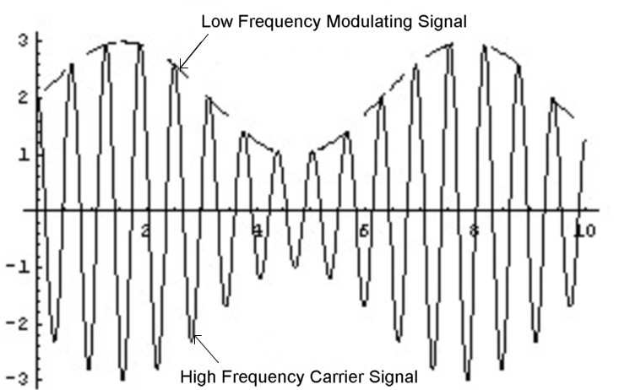
Amplitude Modulation

Slide 26
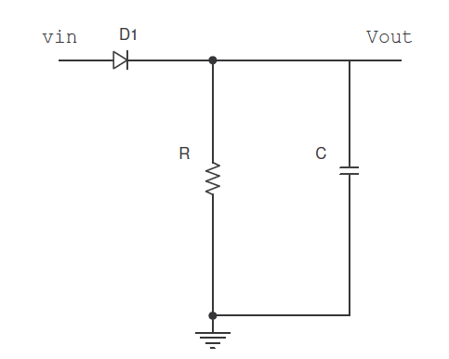
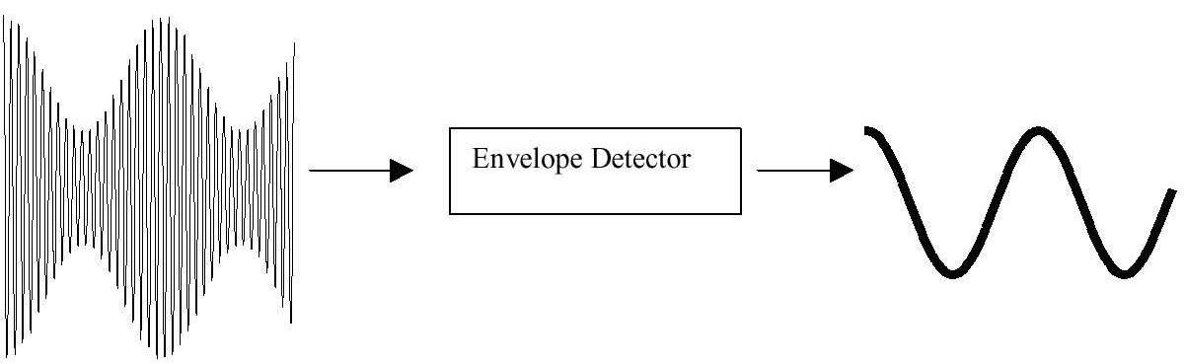
Envelop Detector
Diode

Slide 27
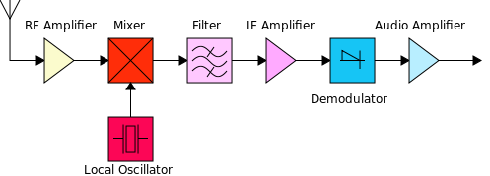
RECEIVER BLOCK DIAGRAM

Slide 28
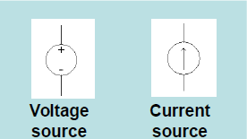
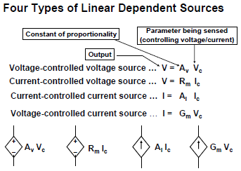
Types of Sources
Independent Source
whose voltage or current does not Depend on other voltages or currents in the circuit
Dependent (controlled) Source
whose magnitude is a function of
another voltage or current in the
circuit

Slide 29
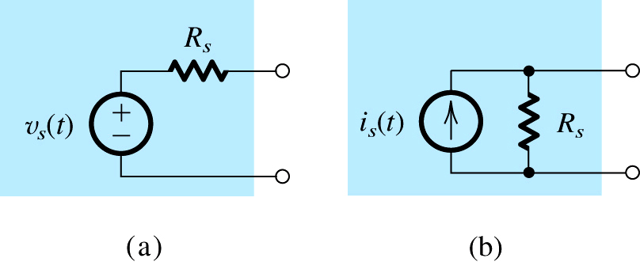
Signals
Signals contain information
Extraction of information needs signal processing
Signal processing by Electronics Systems
Converted to electrical signals through transducers
signal source representations
Thevenin form is preferred
when R_{s} is low
Norton form is preferred
when R_{s} is high
the Thévenin form
the Norton form

Slide 30
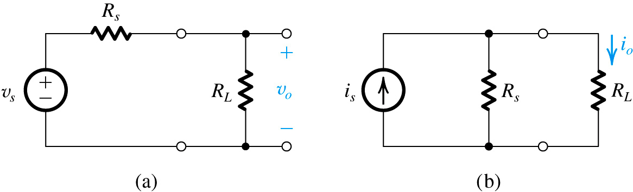
Signals
It is desirable that full signal strength from the source is delivered to the load
The ability is limited by the source resistance
In case of Thevenin form
In case of Norton form
Figure 1.2 Circuits for Example 1.1.

Slide 31
Signals
Signals can also be represented as sum of sinusoids
Fourier series and Fourier Transforms are used as tools to convert time domain signals into frequency domain and vice- versa

Slide 32
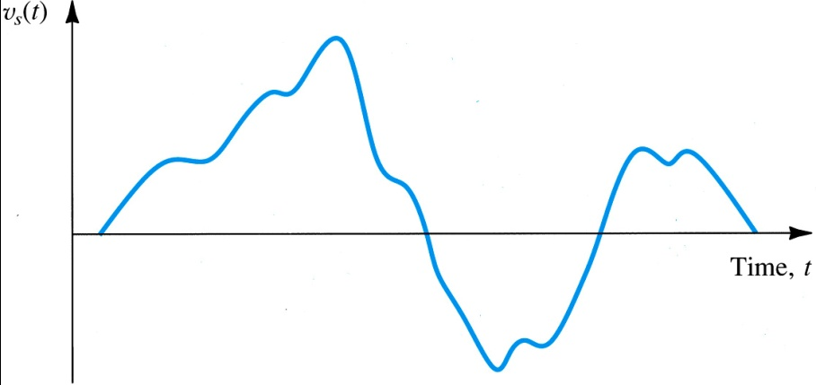
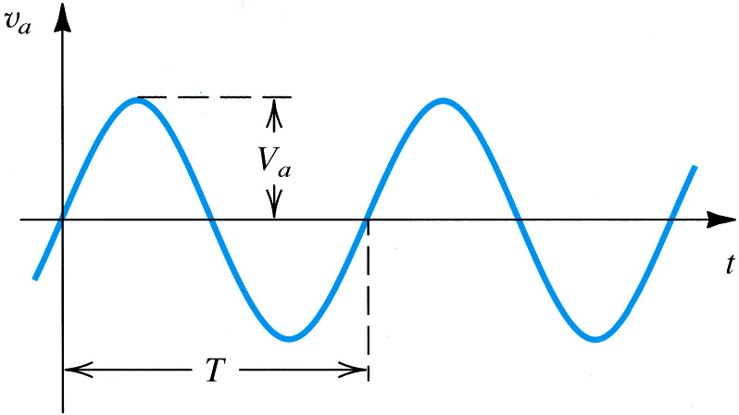
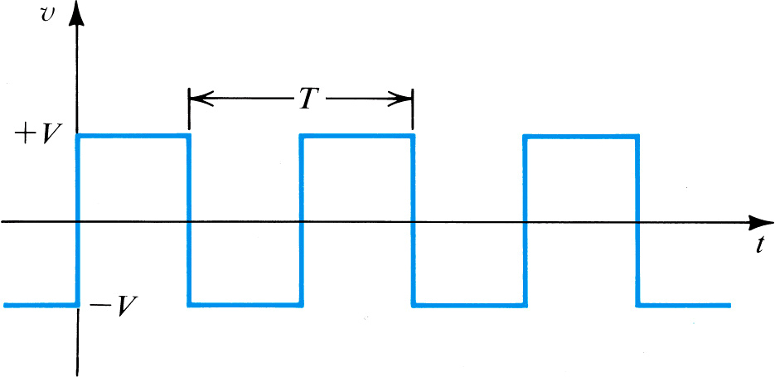
Signal Representation in Time-Domain
An arbitrary voltage signal v_{s}(t)
Sine-wave voltage signal with
Amplitude = V_{a}
Frequency = f = (1/T) Hz
Angular frequency ω = 2πf rad/s
square-wave signal of amplitude V

Slide 33
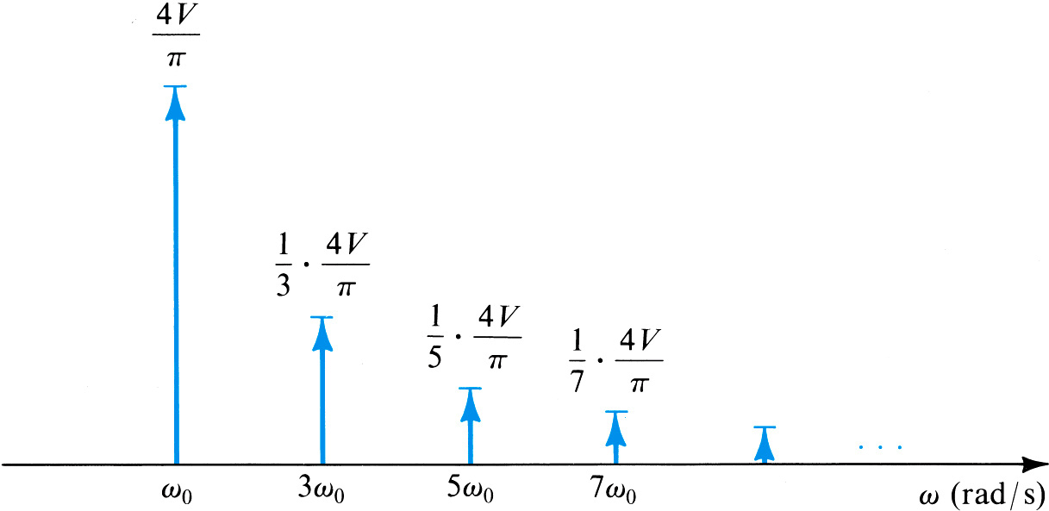
Signal Representation in Frequency-Domain
The frequency spectrum (also known as the line spectrum) of the periodic square wave

Slide 34
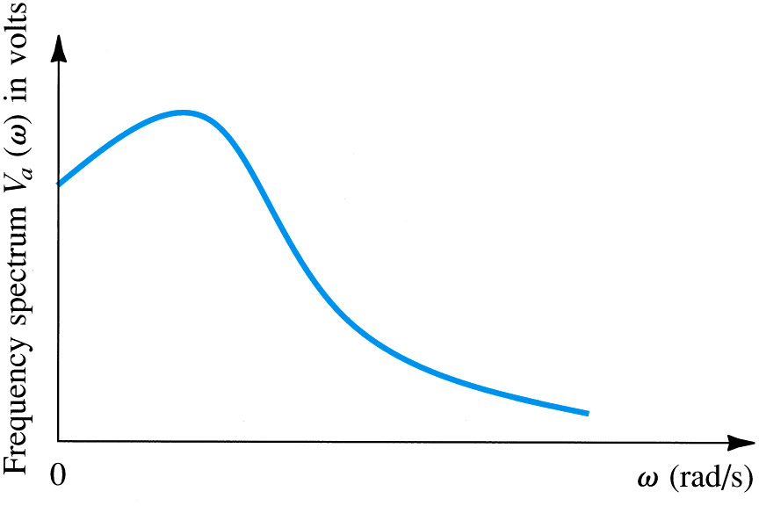
Signal Representation in Frequency-Domain
The frequency spectrum of an arbitrary waveform

Slide 35
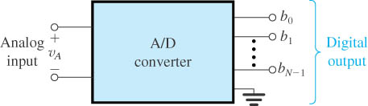
Analogue and Digital Signals
If we sample a signal at regular interval
Represent magnitude of each of the signal sample by a number, then the signal is said to be quantized or digitized
Thus a digital signal is then simply a sequence of numbers that represent the magnitude of successive signal samples
The choice of number system to represent a sample
The binary number is the simplest, can have only two possible values i.e. “0” or “1”

Slide 36
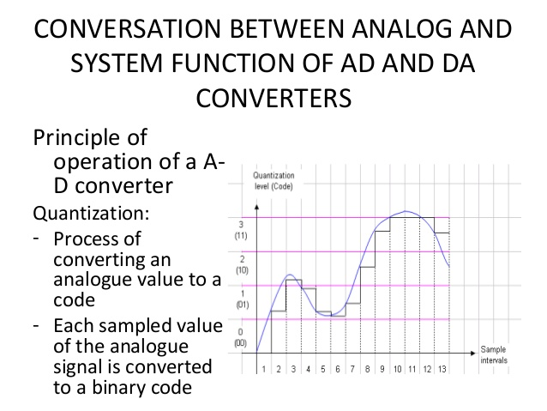

Slide 37
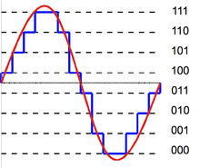
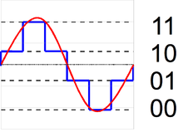
The more levels a quantizer uses, the lower is its quantization noise power
.

Slide 38
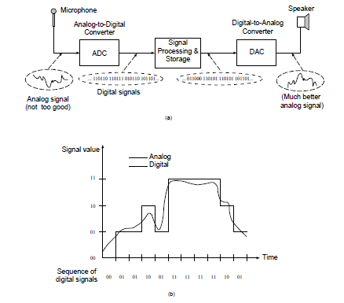
Analogue and Digital Signals

Slide 39
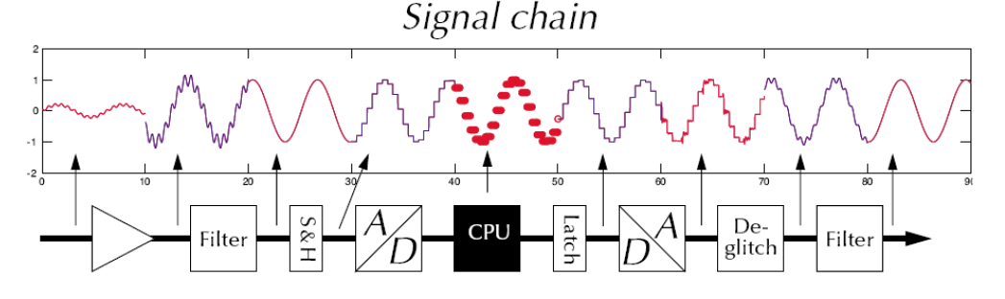
DA & AD Converters

Slide 41
Just what does an A/D converter DO?
Converts analog signals into binary words

Slide 42

Note
According to the Nyquist theorem, the sampling rate must be
at least 2 times the highest frequency contained in the signal.

Slide 43
Analog → Digital Conversion 2-Step Process:
Quantizing - breaking down analog value is a set of finite states
Encoding - assigning a digital word or number to each state and matching it to the input signal

Slide 44
Step 1: Quantizing
Output States | Discrete Voltage Ranges (V)
0 | 0.00-1.25
1 | 1.25-2.50
2 | 2.50-3.75
3 | 3.75-5.00
4 | 5.00-6.25
5 | 6.25-7.50
6 | 7.50-8.75
7 | 8.75-10.0
Example:
You have 0-10V signals. Separate them into a set of discrete states with 1.25V increments. (How did we get 1.25V? See next slide…)

Slide 45
Quantizing
The number of possible states that the converter can output is:
N=2^{n}
where n is the number of bits in the AD converter
Example: For a 3 bit A/D converter, N=2³=8.
Analog quantization size:
Q=(Vmax-Vmin)/N = (10V – 0V)/8 = 1.25V

Slide 46
Encoding
Output States | Output Binary Equivalent
0 | 000
1 | 001
2 | 010
3 | 011
4 | 100
5 | 101
6 | 110
7 | 111
Here we assign the digital value (binary number) to each state for the computer to read.

Slide 47
Accuracy of A/D Conversion
There are two ways to best improve accuracy of A/D conversion:
increasing the resolution which improves the accuracy in measuring the amplitude of the analog signal.
increasing the sampling rate which increases the maximum frequency that can be measured.

Slide 48
Resolution
Resolution (number of discrete values the converter can produce) = Analog Quantization size (Q)
(Q) = Vrange / 2^n, where Vrange is the range of analog voltages which can be represented
limited by signal-to-noise ratio (should be around 6dB)
In our previous example: Q = 1.25V, this is a high resolution. A lower resolution would be if we used a 2-bit converter, then the resolution would be 10/2^2 = 2.50V.

Slide 49
Sampling Rate
Frequency at which ADC evaluates analog signal. As we see in the second picture, evaluating the signal more often more accurately depicts the ADC signal.

Slide 50
Aliasing
Occurs when the input signal is changing much faster than the sample rate.
For example, a 2 kHz sine wave being sampled at 1.5 kHz would be reconstructed as a 500 Hz (the aliased signal) sine wave.
Nyquist Rule:
Use a sampling frequency at least twice as high as the maximum frequency in the signal to avoid aliasing.

Slide 51
Overall Better Accuracy
Increasing both the sampling rate and the resolution you can obtain better accuracy in your AD signals.

Slide 52
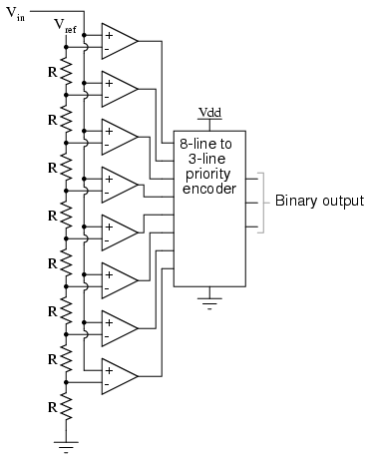
Flash ADC Circuit

Slide 53
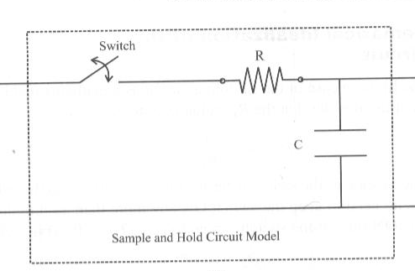
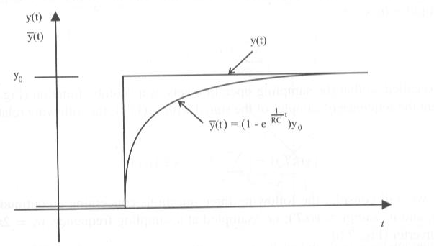
Sampling
Reduction of a continuous signal to a discrete signal
Achieved through sampling and holding circuit
Switch ON – sampling of signal (time to charge capacitor w/ V_{in})
Switch OFF - voltage stored in capacitor (hold operation)
Must hold sampled value constant for digital conversion
Simple Sample and Hold Circuit
Response of Sample and Hold Circuit

Slide 54
Amplifiers
Amplifiers
Voltage Gain
Expressing Gain in Decibels
Amplifier Power Supplies
Amplifier Saturation
Buffer Amplifier
Cascaded Amplifier
Unilateral Models
Frequency Response
Single Time Constant
Operational Amplifier

Slide 55

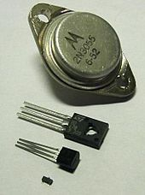
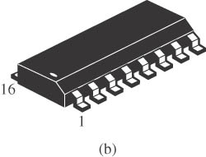
Electronics versus Microelectronics
Early electronic systems incorporated “vacuum tubes,” amplifying devices for radio communication
Finite lifetime and the large size
The first transistor was invented in the 1940s and rapidly replaced vacuum tubes
Transistor had a very long lifetime and a much smaller size than vacuum tubes
In 1960s the field of microelectronics began,
(i.e., the science of integrating many transistors on one chip)
Advances in the technology made it possible to dramatically increase the complexity and No of devices on the chip

Slide 56
Example
Today’s microprocessors contain about 100 million transistors in a chip area of approximately 3 cm x 3 cm (The chip is a few hundred microns thick.)
Suppose integrated circuits were not invented and we attempted to build a processor using 100 million “discrete” transistors.
If each device occupies a volume of 3 mm x 3 mm x 3 mm, determine the minimum volume for the processor.
The minimum volume is 27 mm³ x 10⁸
(a cube about 1.4 m on each side)
The wires connecting the transistors would increase the volume
The processing speed will be slow because of wire length
If each transistor costs 1 cent and weighs 1 g, each processor unit would be priced at one million dollars and weigh 100 tons

Slide 57
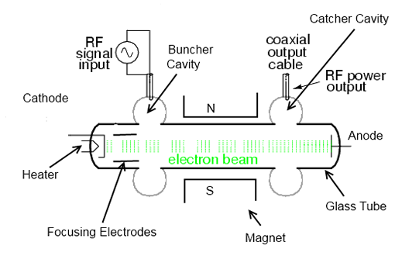
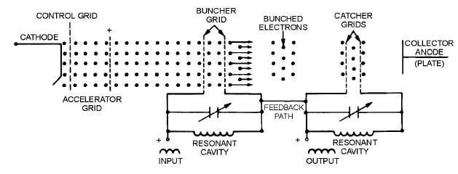
Two cavity klystron
High Power & High Frequency Amplifier

Slide 58
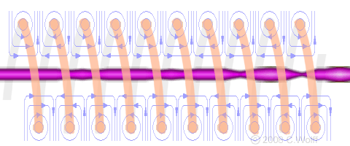
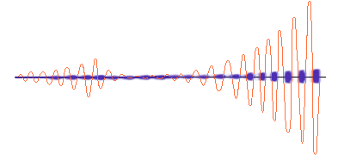
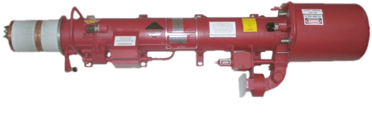
Travelling Wave tube
Wideband High Frequency Amplifier

Slide 59
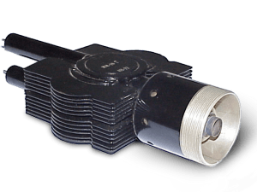
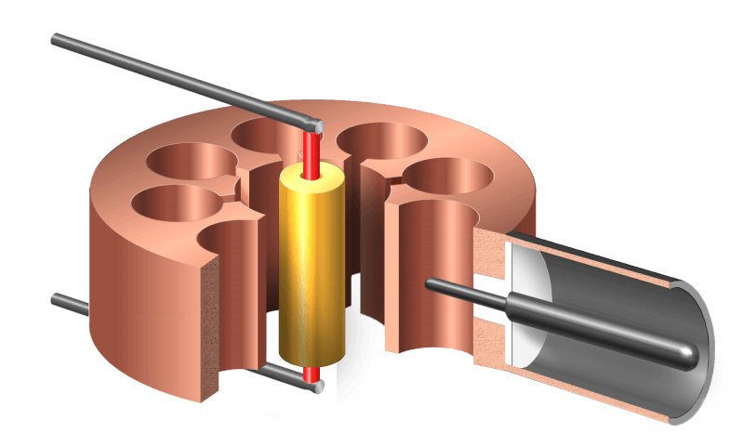
Magnetron
Oscillator and Amplifier

Slide 60
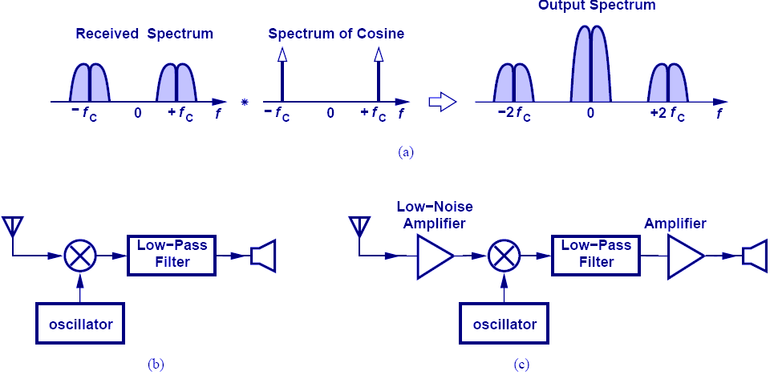
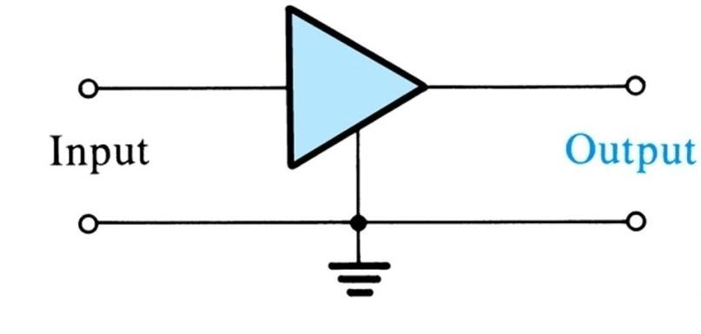
Amplifier
Weak signals need to be amplified before further processing for information extraction
Amplification is fundamental signal processing function and is accomplished by signal amplifier
Examples
Transducers’ output is generally weak (i.e. a few µv or mv)
Radio signal received by a receiver is weak
These signals need to be amplified
Circuit symbol for amplifier

Slide 61
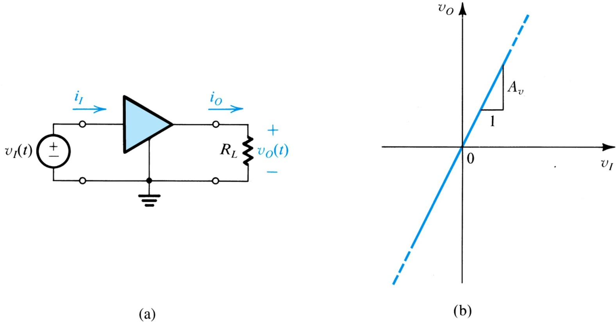
Amplifier Gain
A voltage amplifier with an input signal v_{i}(t) and load R_{L}
Transfer characteristic of linear voltage amplifier with voltage gain A_{v}

Slide 62
Gain in Decibels
Amplifier gain may be expressed in dB (a logarithmic measure)

Slide 63
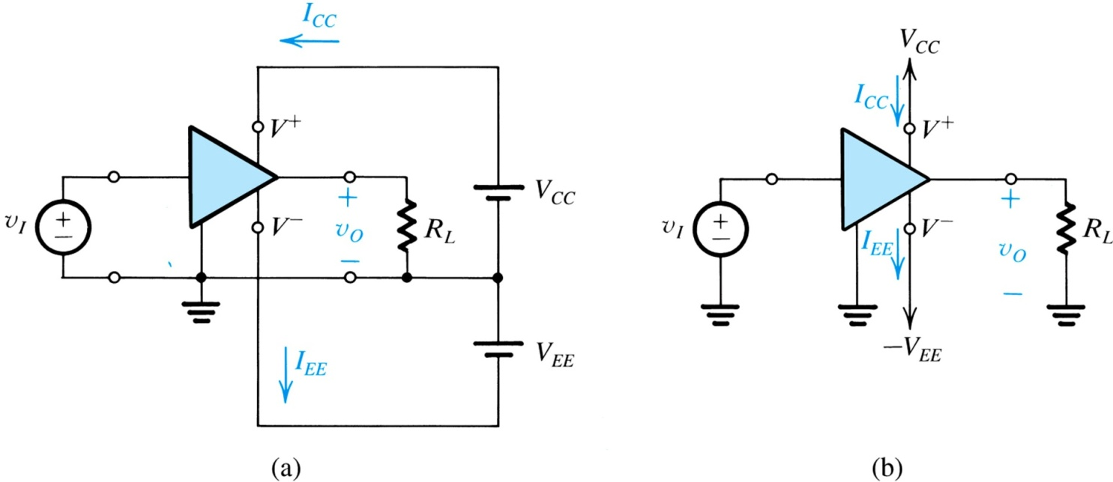
Amplifier Power Supplies and Efficiency
Power delivered to the load is greater than
the power drawn from the source
Where the additional power comes from ??
power source
Some of the power is dissipated by the
amplifier circuit
An amplifier that requires two dc supplies
Amplifier efficiency

Slide 64
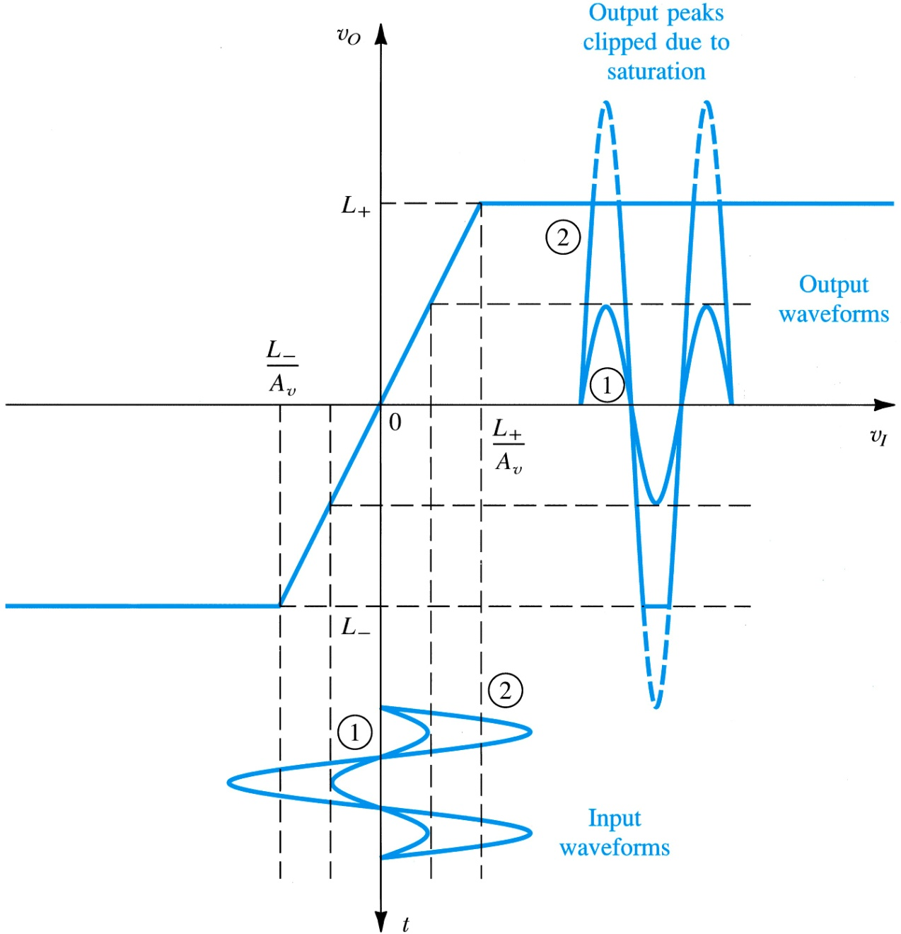
Amplifier Saturation
If the input signal exceeds certain limits, the output peaks are clipped and thus the signal is distorted
Distortion is undesirable as it results in distorted information
An amplifier transfer characteristic that is linear except for output saturation.

Slide 65
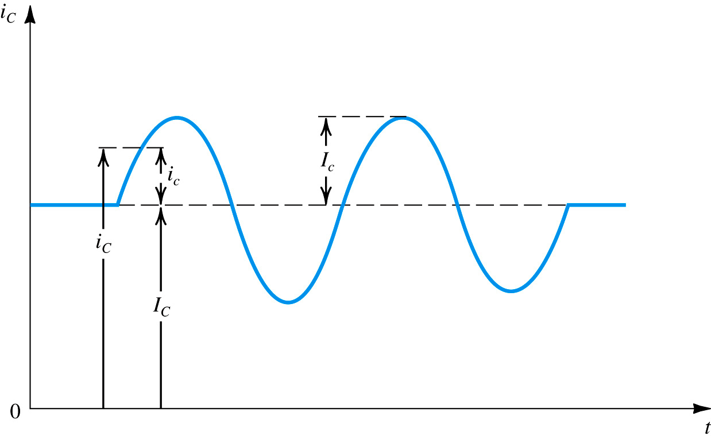
Symbol Convention
Figure 1.15 Symbol convention employed throughout the book.

Slide 66
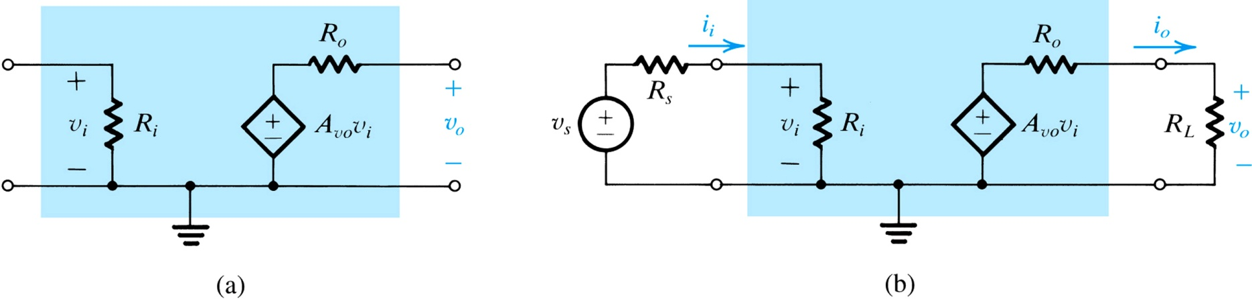
Circuit Model for Voltage Amplifier
The input voltage signal v_{i} appears across the input resistance R_{i}
The output is represented by voltage source dependent on v_{i} in series with the output resistance R_{o}
A_{vo} is the open-circuit voltage gain
Circuit model for the voltage amplifier

Slide 67
Voltage Amplifier
The voltage amplifier with input signal source and load

Slide 68
Exercise
An Amplifier has a voltage gain of 100 V/V and a current gain of 1000 A/A . Express the voltage and current gains in decibels and find power gain .
An amplifier operating from a single 15-v supply provides a 12-v peak –to –peak sine wave signal to a 1k Ohm load and draws negligible input current from the signal source . The dc current drawn from the 15-v supply is 8mA . What is the power dissipated in the amplifier , and what is the amplifier efficiency ?

Slide 69
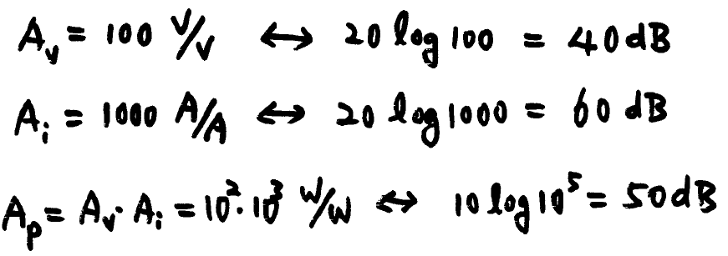
Solution

Slide 70
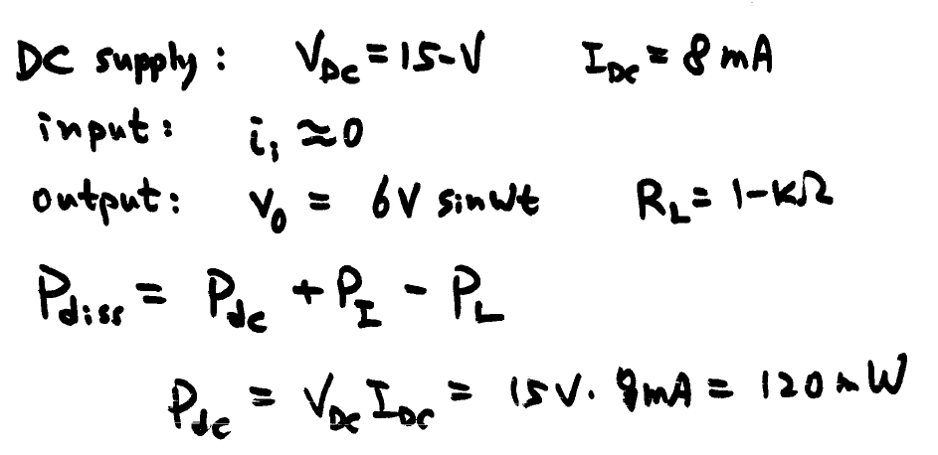
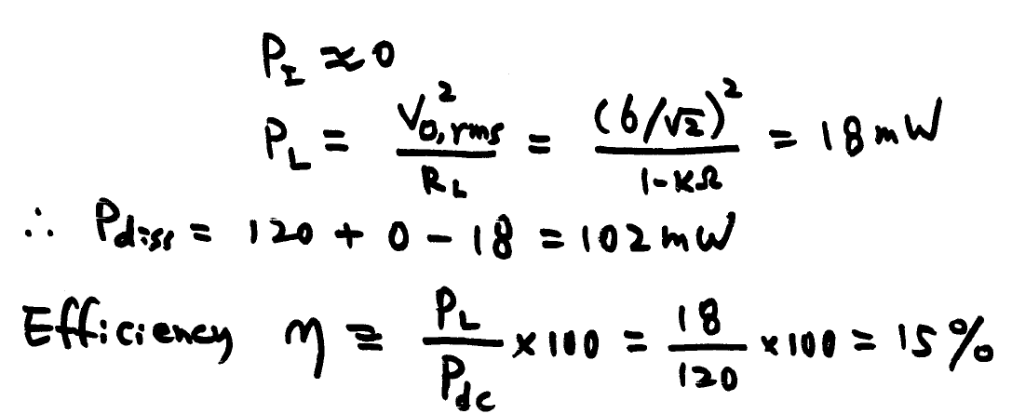
Solution 2

Slide 71
Thévenin’s theorem Review

Slide 72
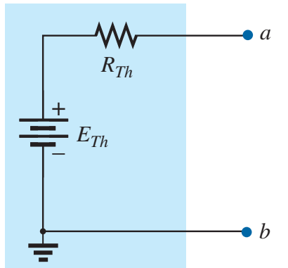
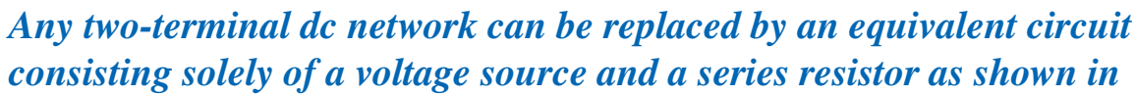

Thévenin’s theorem
Thévenin’s theorem permits the reduction of complex networks to a simpler form for analysis and design.

Slide 73


Example-5
Find the Thevenin equivalent circuit for the shaded area.
Step 1: Remove that portion of the network where the Thévenin equivalent circuit is found.
Step 2: Mark the terminals of the remaining two-terminal network.

Slide 74



Example-5
Step 3: Calculate $R_{TH}$ by first setting all sources to zero and then finding the resultant resistance between the two marked terminals.
$$R_{th}=\frac{3×6}{3+6}=2Ω$$

Slide 75




Example-5
Step 4: Find $E_{TH}$ (open-circuit voltage) by measuring the voltage between the two marked terminals.

Slide 76


Thévenin’s theorem - Advantage
Find the current $I_{L}$ for $R_{L}=2 Ω, 10 Ω, and 100 Ω$
ZA

Slide 77






Maximum Power Transfer Theorem

Slide 78
Maximum Power Transfer VS Efficiency
The Maximum Power Transfer Theorem results in maximum power transfer across the circuit, and not maximum efficiency.

Slide 79










Maximum Power Transfer VS Efficiency
At $R_{th}=R_{L}$ , power transfer is maximum but efficiency in 50%
$$I_{L}=\frac{E_{th}}{R_{th }+R_{L}}= \frac{60}{9+9}=3.333$$
$$P_{Supplied }=60×3.3333=200 W$$
$$P_{9Ω }={\left(3.333\right)}^{2}×9=100 W$$
Thus if $R_{L}=9→η=\frac{100 W}{200 W}=50\%$
$$P_{Supplied }=60×0.5505=33.03 W$$
$$η=\frac{30.3}{60×0.551}=91.7 \%$$

Slide 80


$$V_{th}$$ | $$R_{th}$$ | $$R_{L}$$ | $$I_{L}$$ | $$P_{total}$$ | $$P_{L}$$ | $$η$$
60 | 9 | 5 | 4.29 | 257 | 92.02 | 36%
60 | 9 | 9 | 3.333 | 200 | 100 | 50%
60 | 9 | 50 | 1.02 | 61 | 50.02 | 82%
60 | 9 | 100 | 0.5505 | 33 | 30.31 | 92%
60 | 9 | 500 | 0.118 | 7.08 | 6.96 | 98%

Slide 81










Maximum Power Transfer Theorem - Example
1 - Find the value of $R_{L}$ for maximum power to the load
2 - Find the maximum power to the load
3 - Find the value of $R_{L}$ that would result in an efficiency of 75%
$$(1)$$
$$(2)$$
$$η=0.75=\frac{P_{L}}{P_{E}}=\frac{I_{L}^{2} R_{L}}{I_{L}^{2} (R_{L}+R_{TH})}$$
$$(3)$$
$$R_{L}=\frac{0.75 R_{TH}}{1−0.75}=45 Ω$$
$R_{th}$was 15 , we found that if we select $R_{L }$as 45circuit efficiency increases to 75%

Slide 82

Cascaded Amplifier
Figure 1.17 Three-stage amplifier for Example 1.3.
Work out and understand Example 1.3

Slide 83

Frequency Response of Amplifiers
At a frequency ω , the amplifier gain is characterized by its magnitude (V_{o} /V_{i}) and phase ø

Slide 84

Amplifier Bandwidth
Typical magnitude response of an amplifier

Slide 85

RC Filters
Examples of STC networks
(a) a low-pass network
(b) a high-pass network.

Slide 86


Frequency Response of Low-Pass Filter
(a) Magnitude response (b) phase response

Slide 87


Frequency Response of High-Pass Filter
(a) Magnitude response (b) phase response

Slide 88

Digital Logic Gates

Slide 89
Summary

Slide 90
ELECTRONICS
The branch of physics concerned with the behavior of electrons in the circuits, its control by means of semiconductor devices such as diodes and transistors etc.

Slide 91
SOLID-STATE ELECTRONICS
Transistors control the flow of electrons through solid semiconductor substances rather than through a vacuum, and so transistor technology is often referred to as solid-state electronics.

Slide 92
MICROELECTRONICS
The art of electronic equipment design and construction that uses micro- miniaturization schemes.
The entire body of electronic art that is connected with or applied to the realization of electronic systems from extremely small electronic parts.
All techniques for the manufacture of extremely small electronic circuits, generally including all types of silicon integrated circuits, thin-film circuits, and thick-film circuits
EXAMPLES. Amplifiers, Microprocessor, Micro-controller, Integrated circuits,
cornerstone of computing and communications revolution

Slide 93
SEMICONDUCTOR
A material between conductors and insulators in its ability to conduct electrical current (e.g., silicon, and germanium, gallium arsenide)
Pure state is known as intrinsic state
Today’s IC technology is based entirely on silicon. Our text book mostly deals with SILICON devices only

Slide 97
Fourier series and transform
Animated

Slide 98



Slide 99

Function s(x) (in red) is a sum of six sine functions of different amplitudes and harmonically related frequencies. Their summation is called a Fourier series. The Fourier transform, S(f) (in blue), which depicts amplitude vs frequency, reveals the 6 frequencies and their amplitudes.

Slide 100


Another visualisation of an approximation of a square wave by taking the first 1, 2, 3 and 4 terms of its Fourier series
A visualisation of an approximation of a sawtooth wave of the same amplitude and frequency for comparison

Slide 101


Animated plot of the first five successive partial Fourier series

Slide 102
Problem Solving

Slide 103
Problem Solving: Chapter No 1 Signals & Amplifiers

Slide 115
Home Assignment
Exercises: 1.15, 1.21 D1.24, 1.34
Submit on Monday (2 March-2015)

